Slide 1
Molecular Basis of Next Generation Sequencing
EMD 531
Lecture 4
Joseph Fauver, PhD

Slide 2
Learning objectives
Compare and contrast long-read vs short-read sequencing
Choose library preparation techniques based on specific epidemiological scenarios
Recognize where, when, and how contamination can occur

Slide 3
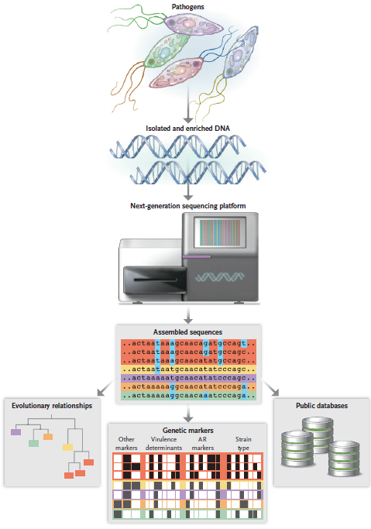
Armstrong et al. (2019) NEJM

Slide 4

Illumina vs ONT
Illumina platforms (MiSeq)
ONT Platforms (MinION)
Read length: 25-300 b.p.
Read Quality: Q30
Output: 1-15Gb
Initial Cost: ??? ($100,000)
Flowcell Cost: $1,000-1,600
Read Length: Varies (up to Mb)
Read Quality: ~Q10
Output: Varies (up to 10’s Gb)
Initial Cost: $1,000
Flowcell Cost: $500-900
Notes:
Genomics can be a really useful tool to study transmission of infectious diseases! All of these things are not necessarily mutually exclusive.
Sequencing technology has typically been relegated to large core centers or incredibly well funded labs. Clinical microbiology labs are in parts of developed countries have this capacity, but it is quite limited. Really has been limited to well funded areas.
Sequencing is not occurring where transmission is taking place. Typically samples are being collected in one area of the world, shipped off somewhere else for sequencing, then that data transferred else where and being analyzed. This is slow and not usefully for “real time” detection.
All of this flies in the face of recent pushes in global health to actually build capacity, infrastructure, and expertise. Especially in the world of neglected tropical diseases. To actually meet these goals, all steps of the process from sample collection, processing, sequencing, and analysis should be done IN COUNTRY.

Slide 5
MinION- why use it?

Slide 6
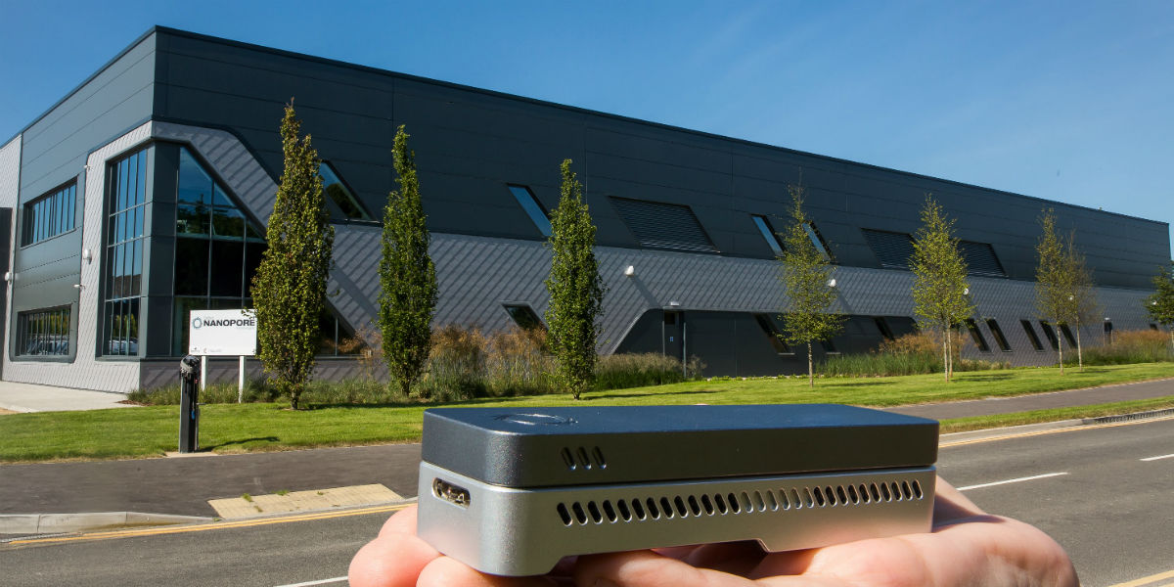
MinION- why use it?
Small
Photo courtesy of ONT

Slide 7
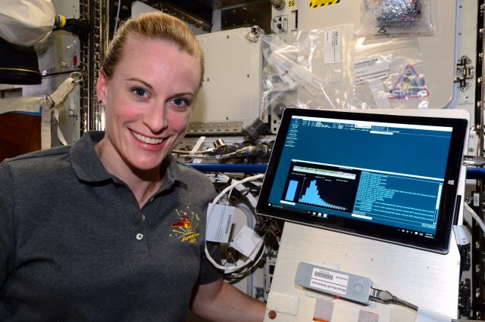
MinION- why use it?
Small
Portable
Photo courtesy of ONT
Photo courtesy of Front-Line Genomics
Notes:
Here is Kate Rubins

Slide 8
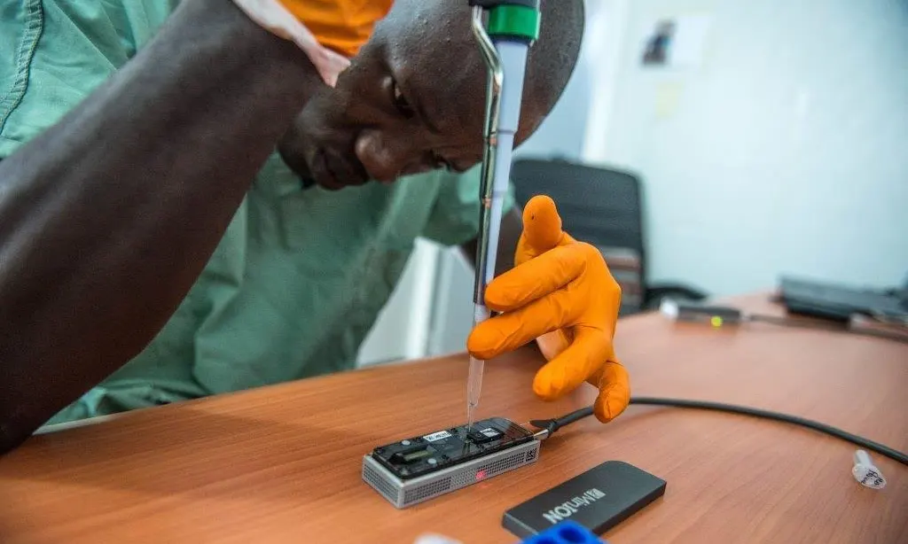
MinION- why use it?
Small
Portable
“Real time”
Photo courtesy of ONT
Photo courtesy of Front-Line Genomics
Photo courtesy of The Guardian

Slide 9
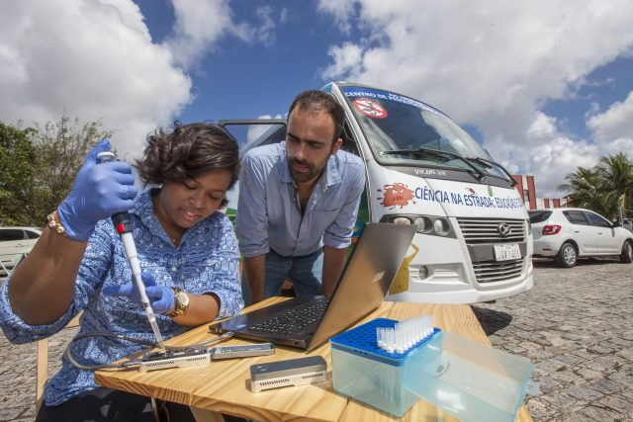
MinION- why use it?
Small
Portable
“Real time”
Self-contained
Photo courtesy of ONT
Photo courtesy of Front-Line Genomics
Photo courtesy of The Guardian
Photo courtesy of Front-Line Genomics

Slide 10
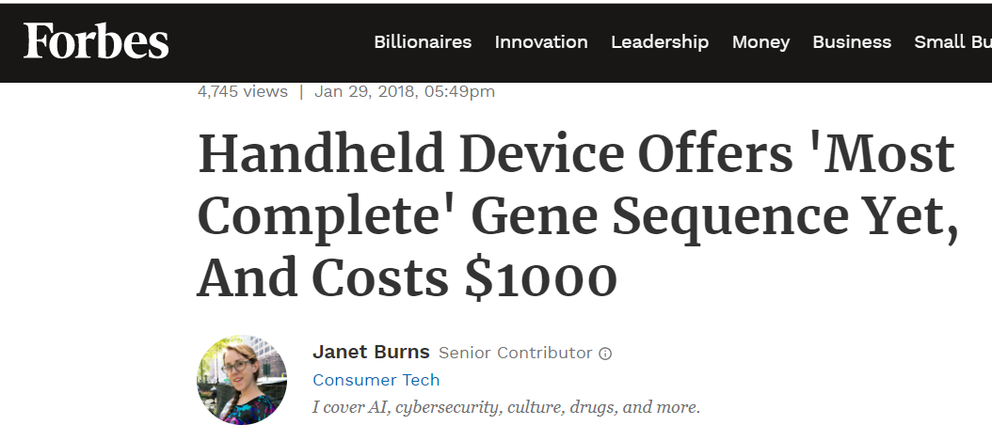
MinION- why use it?
Small
Portable
“Real time”
Self-contained
Inexpensive
Photo courtesy of ONT
Photo courtesy of Front-Line Genomics
Photo courtesy of The Guardian
Photo courtesy of Front-Line Genomics
Photo courtesy of Forbes

Slide 11
Sequencing in real time!
Sequencing DENV4 Zika virus on the MinION

Slide 12
Terminology list
Any questions?

Slide 13
Library Preparation

Slide 14
Library Preparation-Molecular techniques to generate libraries for sequencing
Notes:
Effectively what we are trying to do is get from this to this.

Slide 15

Library Preparation-Molecular techniques to generate libraries for sequencing
Total Nucleic Acid
Finished Library
Notes:
Effectively what we are trying to do is get from this to this.

Slide 16
General Library Preparation Workflow
Nucleic Acid extraction
Generate Double Stranded DNA
Add bits (DNA) onto the ends of dsDNA
Put on sequencer
Notes:
Physical space, hoods, separate equipment, different rooms (ideal), unidirectional

Slide 17


Metagenomic vs. Amplicon
Metagenomic
Sequences everything
Enrichment and depletion strategies
Amplicon
Sequences targets generated via PCR
Incredibly specific
Notes:
All sequencing techniques that dictate how the sample will be prepared for sequencing.
16S

Slide 18
Metagenomic Sequencing General Workflow (RNA Seq)
Nucleic Acid Extraction
Get rid of host N/A*
Make dsDNA*
Add bits (DNA) onto the ends of dsDNA
Sequence
*Common Depletion/Enrichment Steps

Slide 19
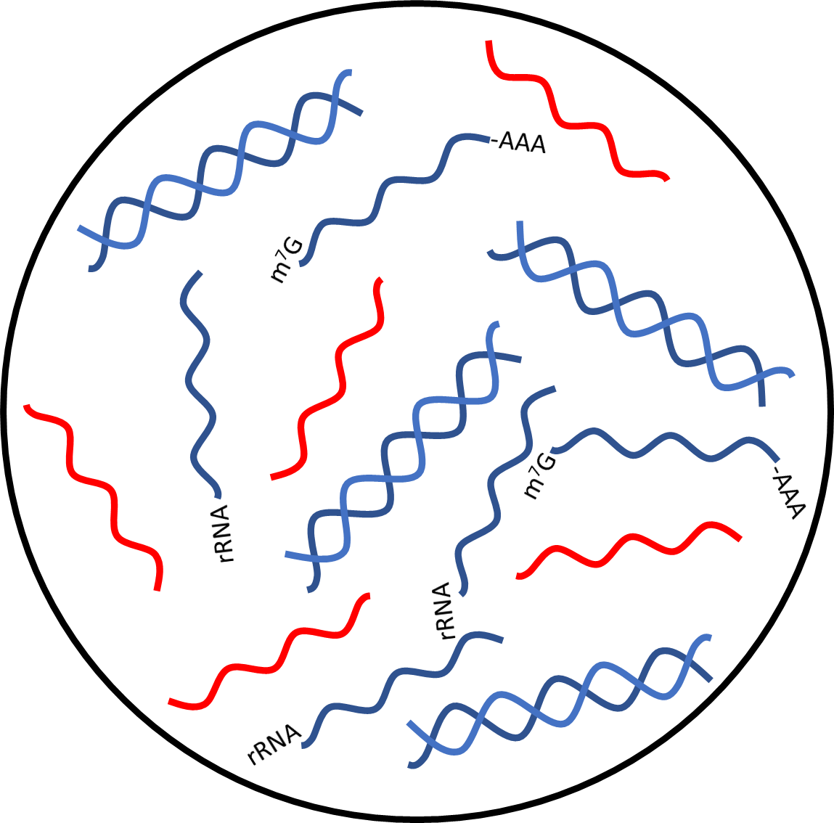

Scenario: Dengue virus infection Sample: Serum Question: What is the serotype?
Total Nucleic Acid
Viral RNA
Host RNA
Host DNA
Notes:
Lets say this is from serum of a patient infected with an arbovirus. We don’t know what it is.
Most nucleic acid extraction kits will extract total nucleic acid (RNA and DNA)
What do we think the most common nucleic acid species is? (Probably rRNA, maybe virus depends on the virus)

Slide 20
Class Question
What is likely the most common nucleic acid in the sample?
Host DNA
Host transcripts (mRNA)
Host ribosomal RNA (rRNA)
Viral RNA

Slide 21
Metagenomic Sequencing General Workflow (RNA Seq)
Nucleic Acid Extraction
Get rid of host N/A*
Make dsDNA*
Add bits (DNA) onto the ends of dsDNA
Sequence
*Common Depletion/Enrichment Steps

Slide 22
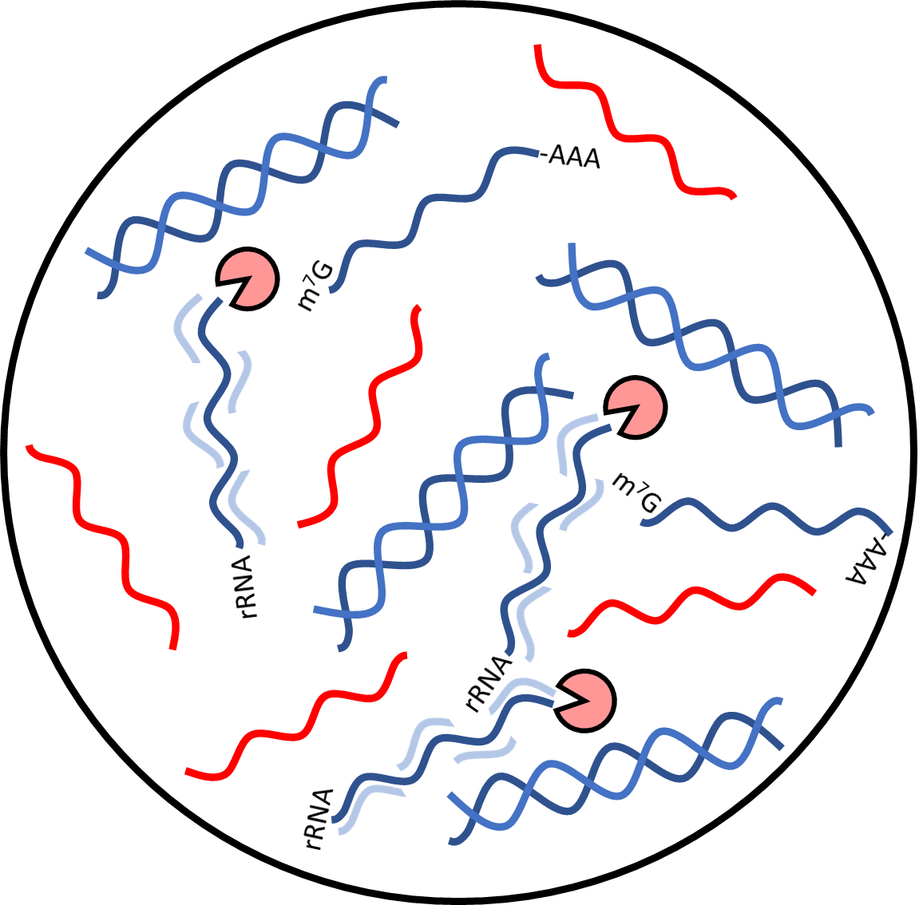


rRNA Depletion + DNase Treatment
rRNA probe hybridization
+
Rnase H treatment
Rnase H
Viral RNA
rRNA probes
DNase
Host RNA
RNase inhibitors
Host DNA

Slide 23
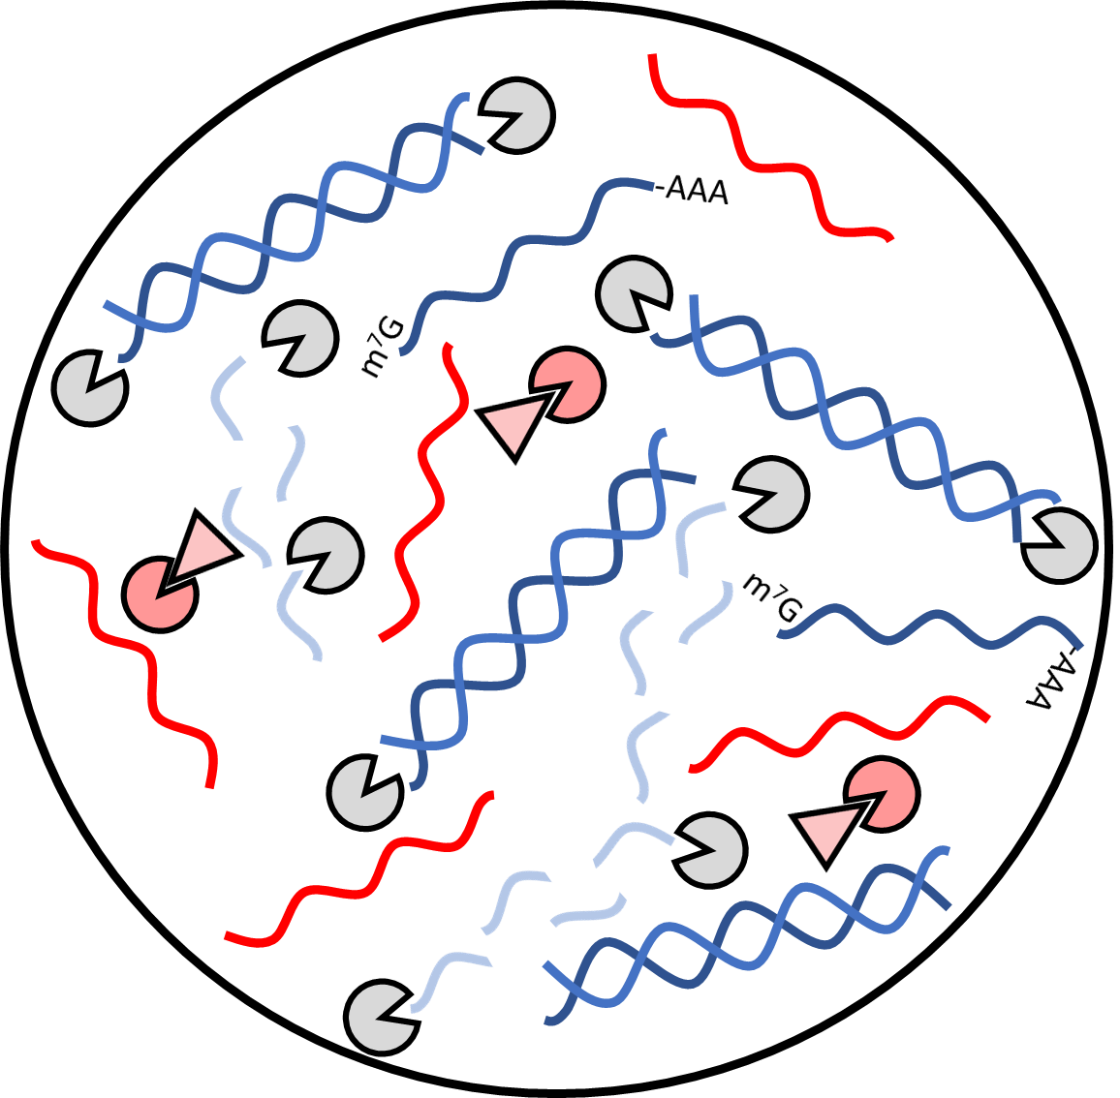
rRNA Depletion + DNase Treatment
rRNA probe hybridization
+
Rnase H treatment
RNase inhibition
+
DNase treatment
Rnase H
Viral RNA
rRNA probes
DNase
Host RNA
RNase inhibitors
Host DNA

Slide 24
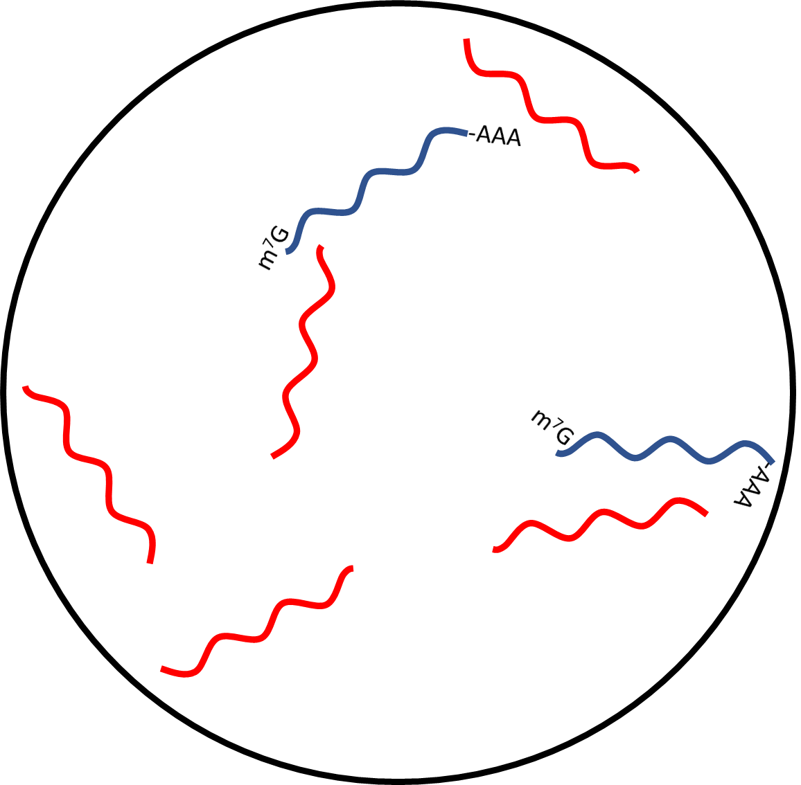
rRNA Depletion + DNase Treatment
rRNA probe hybridization
+
Rnase H treatment
RNase inhibition
+
DNase treatment
Host + viral RNA
Rnase H
Viral RNA
rRNA probes
DNase
Host RNA
RNase inhibitors
Host DNA

Slide 25
Metagenomic Sequencing General Workflow (RNA Seq)
Nucleic Acid Extraction
Get rid of host N/A*
Make dsDNA*
Add bits (DNA) onto the ends of dsDNA
Sequence
*Common Depletion/Enrichment Steps

Slide 26
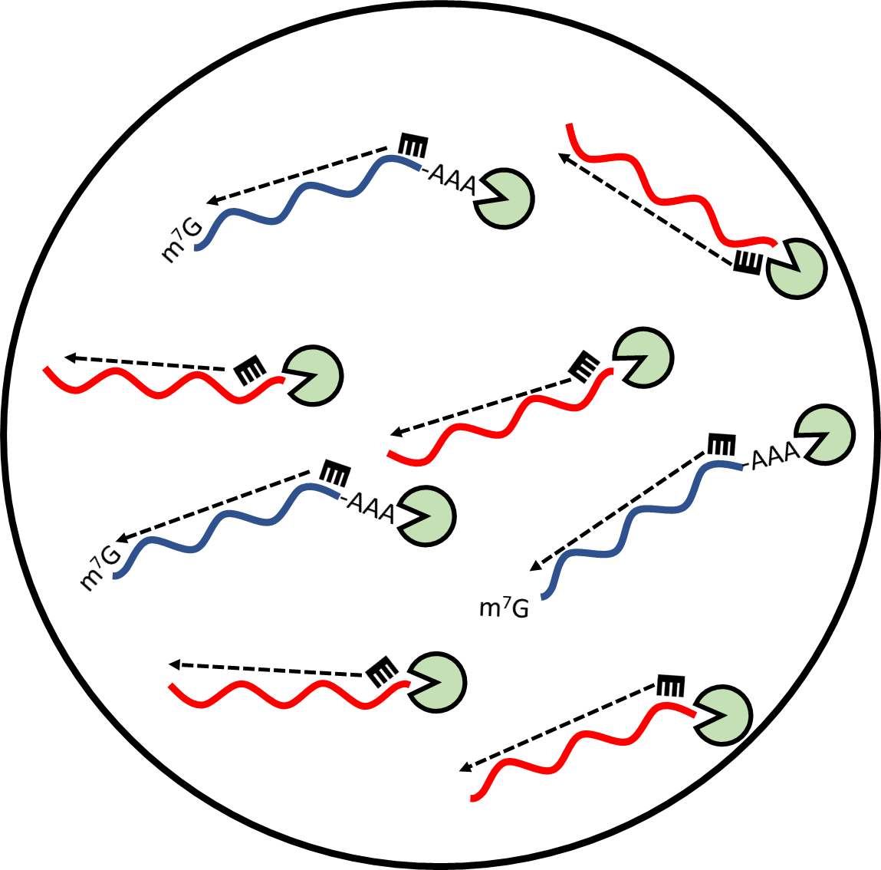

cDNA Synthesis (1st strand)
Reverse Transcription
RNA/cDNA hybrids
Reverse transcriptase
Viral RNA
Host RNA
Random Hexamer
Viral cDNA
Host cDNA

Slide 27
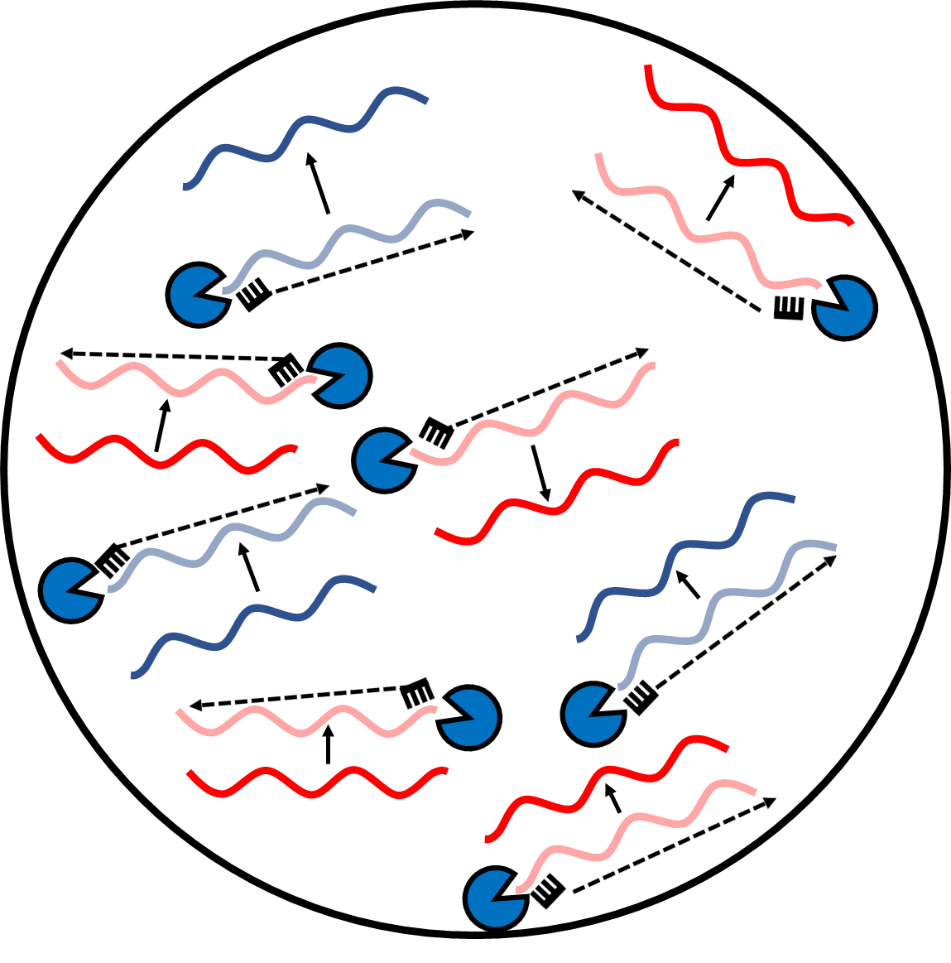

cDNA Synthesis (2nd strand)
Reverse Transcription
ds-cDNA
DNA Polymerase
Viral RNA
Host RNA
Random Hexamer
Viral cDNA
Host cDNA

Slide 28
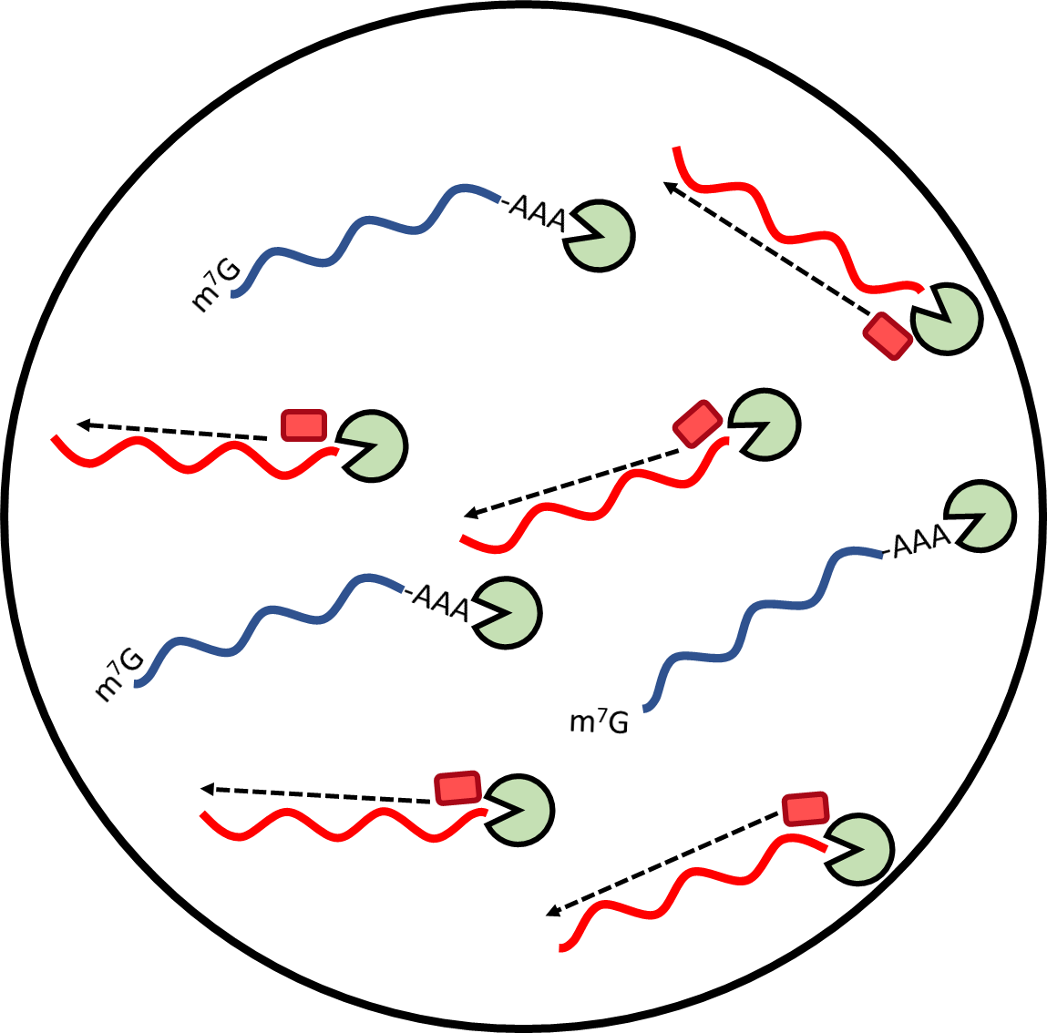
cDNA Synthesis (1st strand) with primer enrichment
Reverse Transcription
RNA/cDNA hybrids
Reverse transcriptase
Viral RNA
Host RNA
Targeted -mer
Viral cDNA

Slide 29
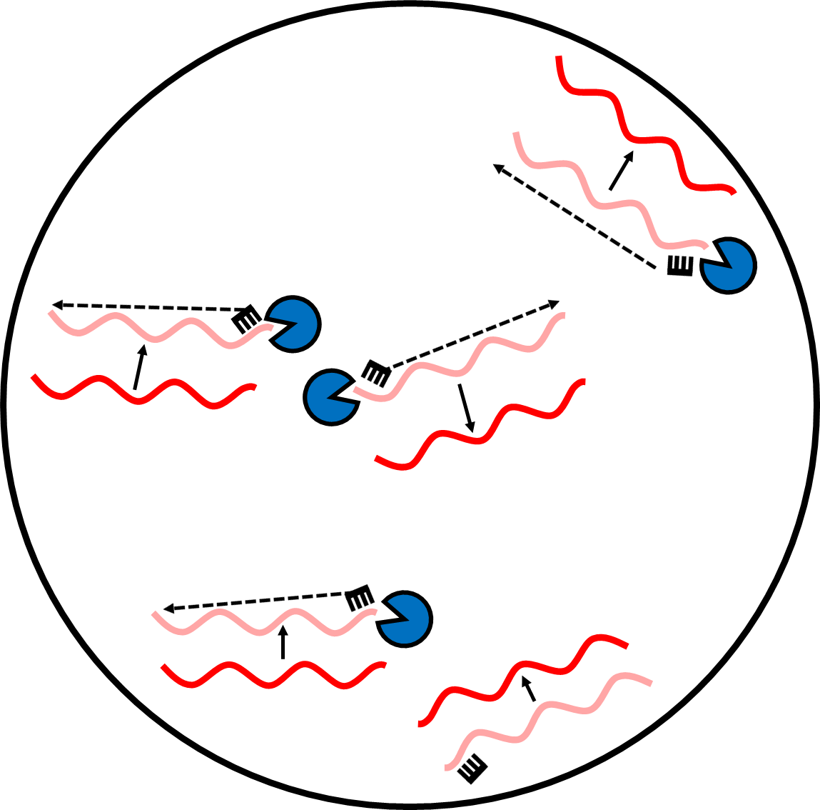

cDNA Synthesis (2nd strand) with primer enrichment
Reverse Transcription
ds-cDNA
DNA Polymerase
Viral RNA
Host RNA
Random Hexamer
Viral cDNA
Host cDNA

Slide 30
Metagenomic Sequencing General Workflow (RNA Seq)
Nucleic Acid Extraction
Get rid of host N/A*
Make dsDNA*
Add bits (DNA) onto the ends of dsDNA
Sequence
*Common Depletion/Enrichment Steps

Slide 31
Class question
Based off our readings, where can common sources of contamination occur in metagenomics library preparations?

Slide 32
Amplicon Sequencing General Workflow
N/A extraction
PCR amplicon generation
Add bits (DNA) onto the ends of dsDNA
Sequence
Notes:
Going to talk about the molecular biology aspects of what is happening, sprinkled in here is a lot of clean up steps, size selections, determining which index sequences you should be using, fragment length checks, concentration checks, etc..

Slide 33
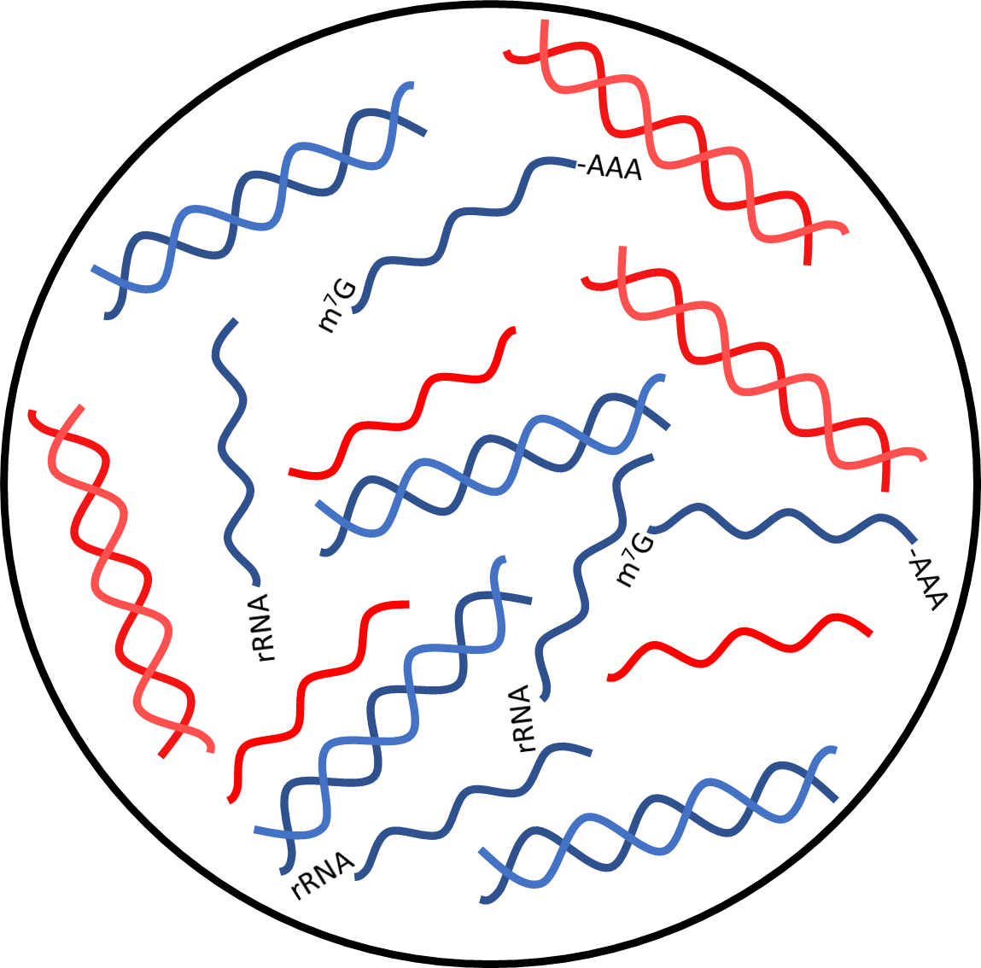
Scenario: Plasmodium Infection Sample: Whole Blood Question: Are there SNPs in the PFK13 that would render parasites resistant to Artemisinin?
Total Nucleic Acid
Plasmodium DNA
Host DNA
Plasmodium RNA
Host RNA
Notes:
Plasmodium
Most nucleic acid extraction kits will extract total nucleic acid (RNA and DNA)
What do we think the most common nucleic acid species is? (Probably rRNA, maybe virus depends on the virus)

Slide 34
Amplicon Sequencing General Workflow
N/A extraction
PCR amplicon generation
Add bits (DNA) onto the ends of dsDNA
Sequence
Notes:
Going to talk about the molecular biology aspects of what is happening, sprinkled in here is a lot of clean up steps, size selections, determining which index sequences you should be using, fragment length checks, concentration checks, etc..

Slide 35
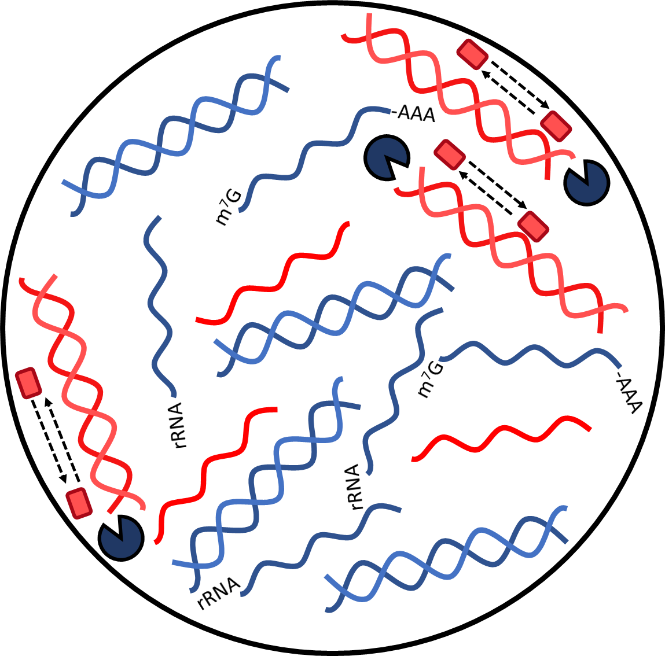
PCR Amplicon Generation
Routine PCR
ds-cDNA
DNA Polymerase
Plasmodium DNA
Host DNA
Targeted Primers
Plasmodium RNA
Host RNA

Slide 36
Amplicon Sequencing General Workflow
N/A extraction
PCR amplicon generation
Add bits (DNA) onto the ends of dsDNA
Sequence
Notes:
Going to talk about the molecular biology aspects of what is happening, sprinkled in here is a lot of clean up steps, size selections, determining which index sequences you should be using, fragment length checks, concentration checks, etc..

Slide 37
Class Question
Based off our readings, where can common sources of contamination occur in amplicon-based library preparations?

Slide 38
Addition of adaptors and indexes
Index
Adaptor
dsDNA Fragment
Adaptor
Index
Adaptors are ubiquitous for NGS
Different depending on platform
Indexes are used for multiplexing
Ligation, PCR, Tagmentation
Anatomy of a finished Illumina library
Index
dsDNA Fragment
Index
Anatomy of a finished MinION library
Motor Protein
Notes:
There are a variety of different ways to add adaptors and indexes. Ligation, tagmentation, PCR, etc.
Lots of kits available

Slide 39
Sequencing

Slide 40
Class Discussion
From the videos posted before class and the previous lecture, what are some key differences in Illumina sequencing and Nanopore sequencing?
Notes:
Data type, how the molecule is “read”, outputs, etc.
Sequencing by synthesis (Illumina video)
Notes: Capped read length, accuracy measurements, cluster generation, excitement and fluorescence, data quantity
Single-molecule sequencing (MinION video)
Notes: Theoretical read lengths, error rates, error types, signal data, basecalling, data quantity

Slide 41
Sequencing platforms
Illumina
iSeq
MiSeq
NextSeq
HiSeq
NovaSeq
Oxford Nanopore Technologies
MinION
GridION
PromethION
Notes:
Effectively what we are trying to do is get from this to this.

Slide 42
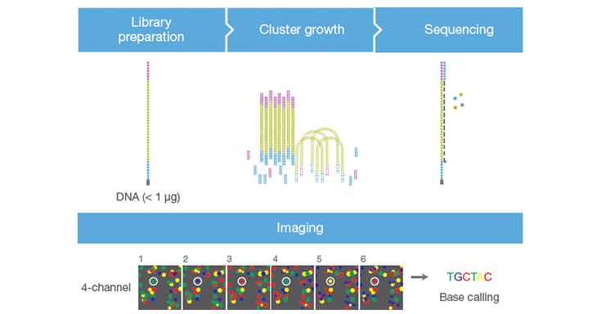
Illumina Sequencing

Slide 43
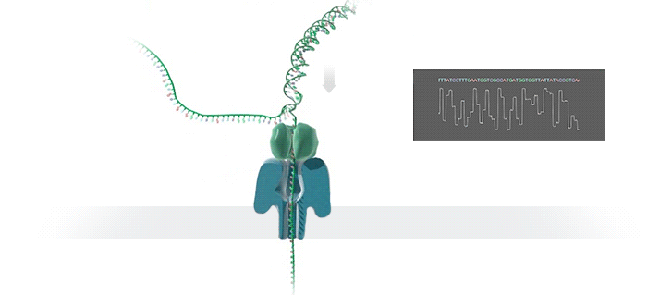
MinION Sequencing
Photo credit: Oxford nanopore technologies

Slide 44
Let’s check on our sequencing run

Slide 45
Considerations for Data Analysis

Slide 46
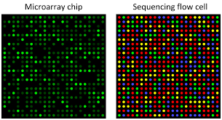
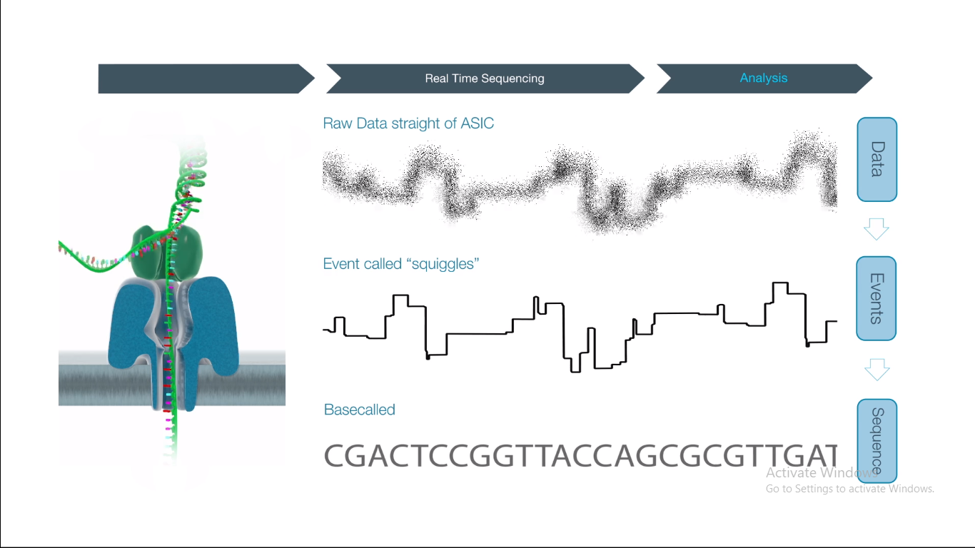
How do we get from molecule to sequence?
How do we get from sequence to genome?
Illumina
Nanopore
.FastQ
ATCGATCGATC…
ATCGATCGATCATCGGATCGATCGACGATACGTACGACTACGCATACGACTGACTGACGACGTACGATCGACGACTGACTACGA…
ATCGATCGATC…
Notes:
Effectively what we are trying to do is get from this to this.

Slide 47
How do we get from molecule to sequence?
How do we get from sequence to genome?
Illumina
Nanopore
.FastQ
ATCGATCGATC…
ATCGATCGATCATCGGATCGATCGACGATACGTACGACTACGCATACGACTGACTGACGACGTACGATCGACGACTGACTACGA…
ATCGATCGATC…
Notes:
Fortunately for us, both Illumina and MinION have proprietary software that does this for us. Automatically. After we sequence something, we get data as .fastq files.

Slide 48
How do we get from molecule to sequence?
How do we get from sequence to genome?
Illumina
Nanopore
.FastQ
ATCGATCGATC…
ATCGATCGATCATCGGATCGATCGACGATACGTACGACTACGCATACGACTGACTGACGACGTACGATCGACGACTGACTACGA…
ATCGATCGATC…
Notes:
Fortunately for us, both Illumina and MinION have proprietary software that does this for us. Automatically. After we sequence something, we get data as .fastq files.

Slide 49
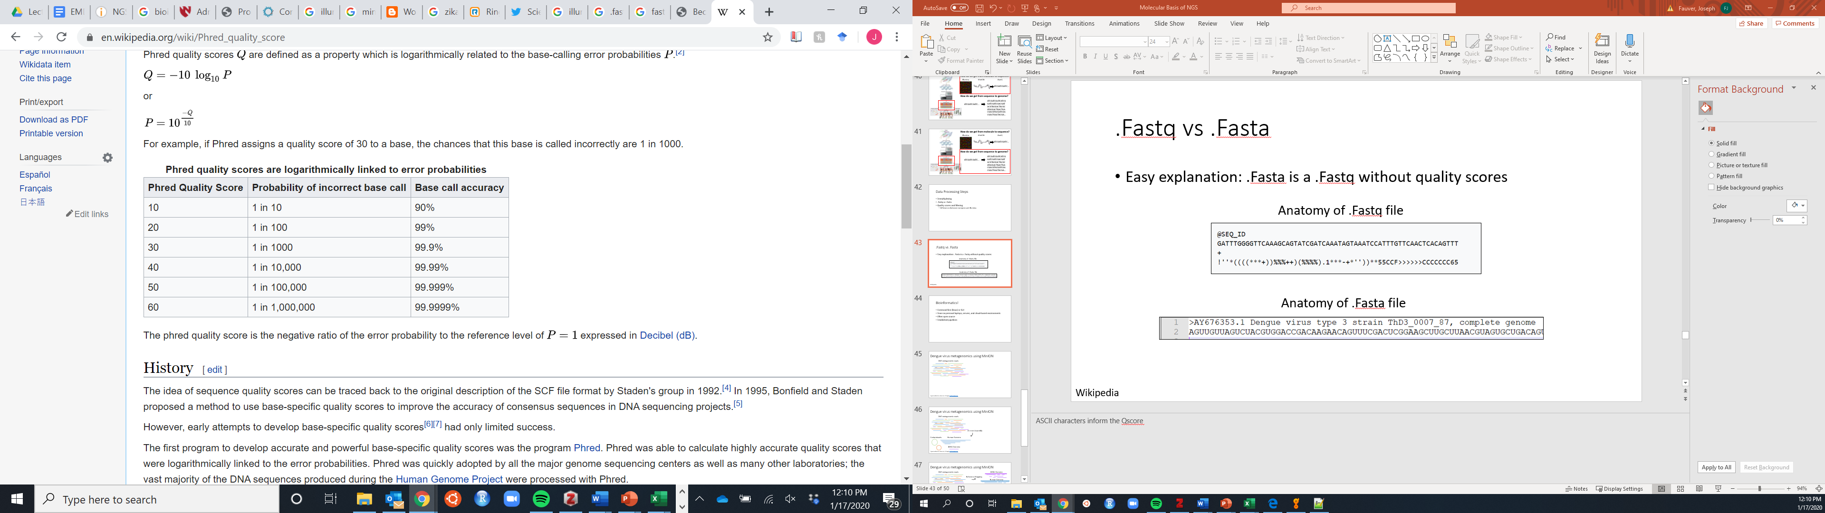
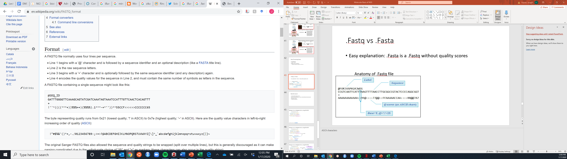
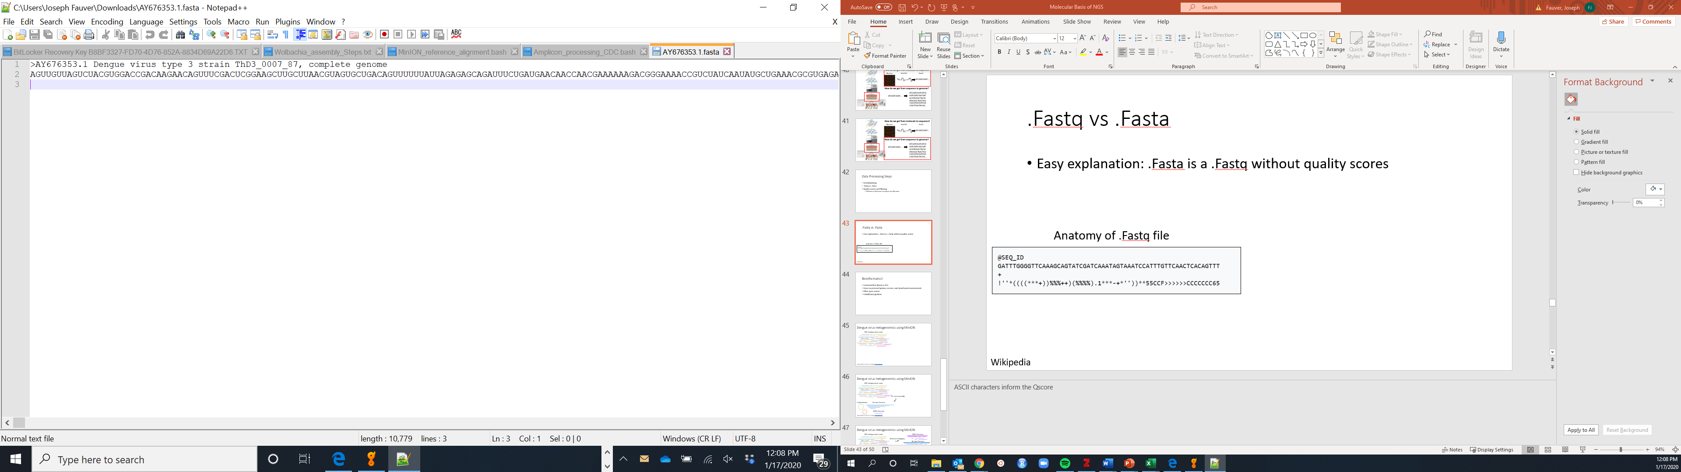
.Fastq vs .Fasta
Anatomy of .Fastq file
Anatomy of .Fasta file
Easy explanation: .Fasta is a .Fastq without quality scores
Wikipedia
Notes:
ASCII characters inform the Qscore

Slide 50
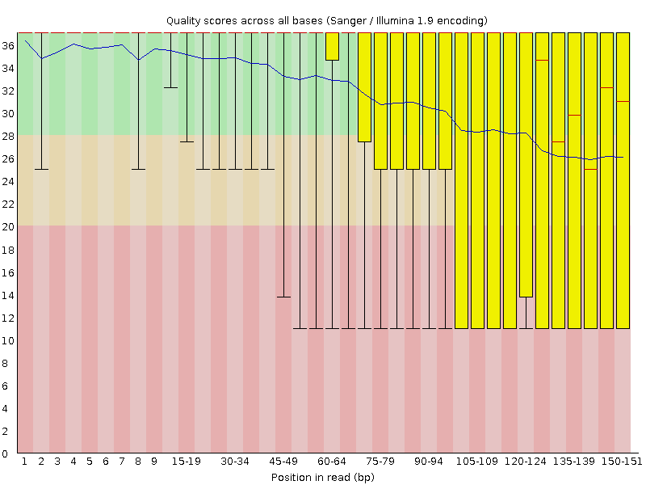
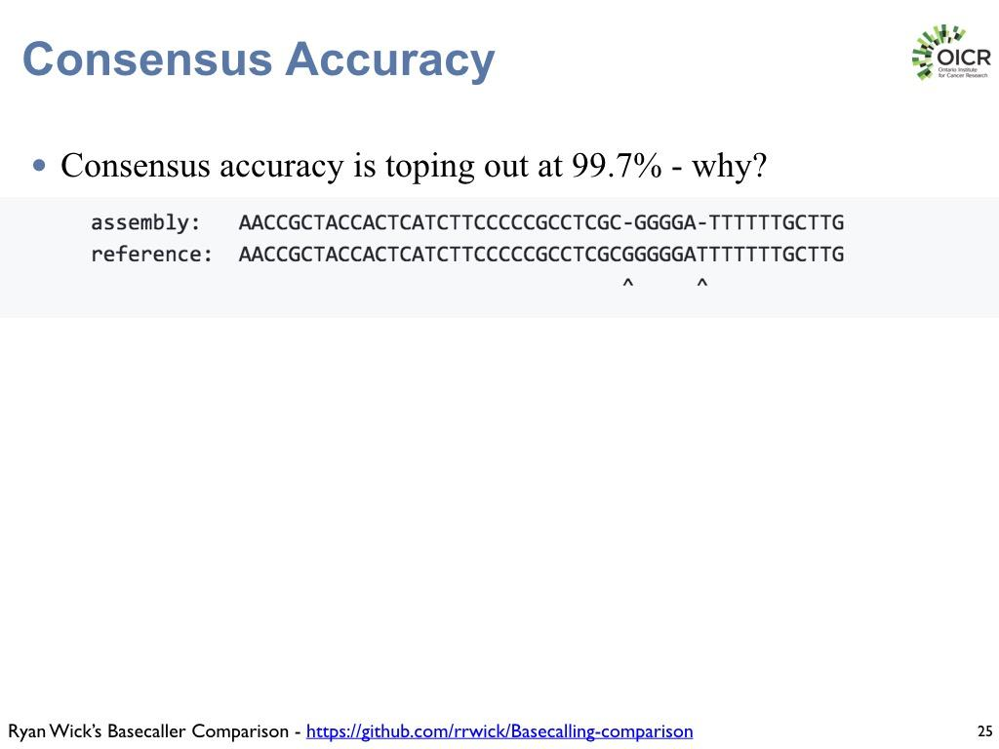
Error profiles of Illumina vs. Nanopore
Illumina
Nanopore
Notes:
Illumina, per base quality drops off at the ends of reads
Nanopore, homopolymer regions are difficult to resolve.

Slide 51
Bioinformatics!
Command line (linux) or GUI
Done on personal laptops, servers, and cloud-based environments
Notes:
For our purposes of performing phylogenetic analysis, we need to get from sequence data to complete genes or genomes. Effectively two ways to do this: de novo assembly or reference-based mapping and consensus.

Slide 52
Dengue virus metagenomics using MinION
ONT metagenomic reads
Figured modified from Meren lab U Chicago (http://merenlab.org)
Notes:
Samples from multiple years

Slide 53

Dengue virus metagenomics using MinION
ONT metagenomic reads
De novo Assembly
Contaminants
Human Genome
DENV Genome
Figured modified from Meren lab U Chicago (http://merenlab.org)
Notes:
Requires no prior knowledge. Untargeted, unbiased.

Slide 54
Dengue virus metagenomics using MinION
ONT metagenomic reads
DENV Genome
Reference Mapping
Human Genome
De novo Assembly
Contaminants
Contaminants
Human Genome
DENV Genome
Figured modified from Meren lab U Chicago (http://merenlab.org)
Notes:
But we knew we had Dengue virus in these samples, sowe

Slide 55
Amplicon sequencing data

Slide 56
Amplicon sequencing data
Reference Mapping

Slide 57
Amplicon sequencing data
Reference Mapping
Consensus Generation

